Slide 1
Synapse Analytics Azure DevOps

Slide 2





Deliver
with Azure DevOps
Azure Boards
Azure Repos
Azure Pipelines
Azure Artifacts
Azure Test Plans

Slide 3
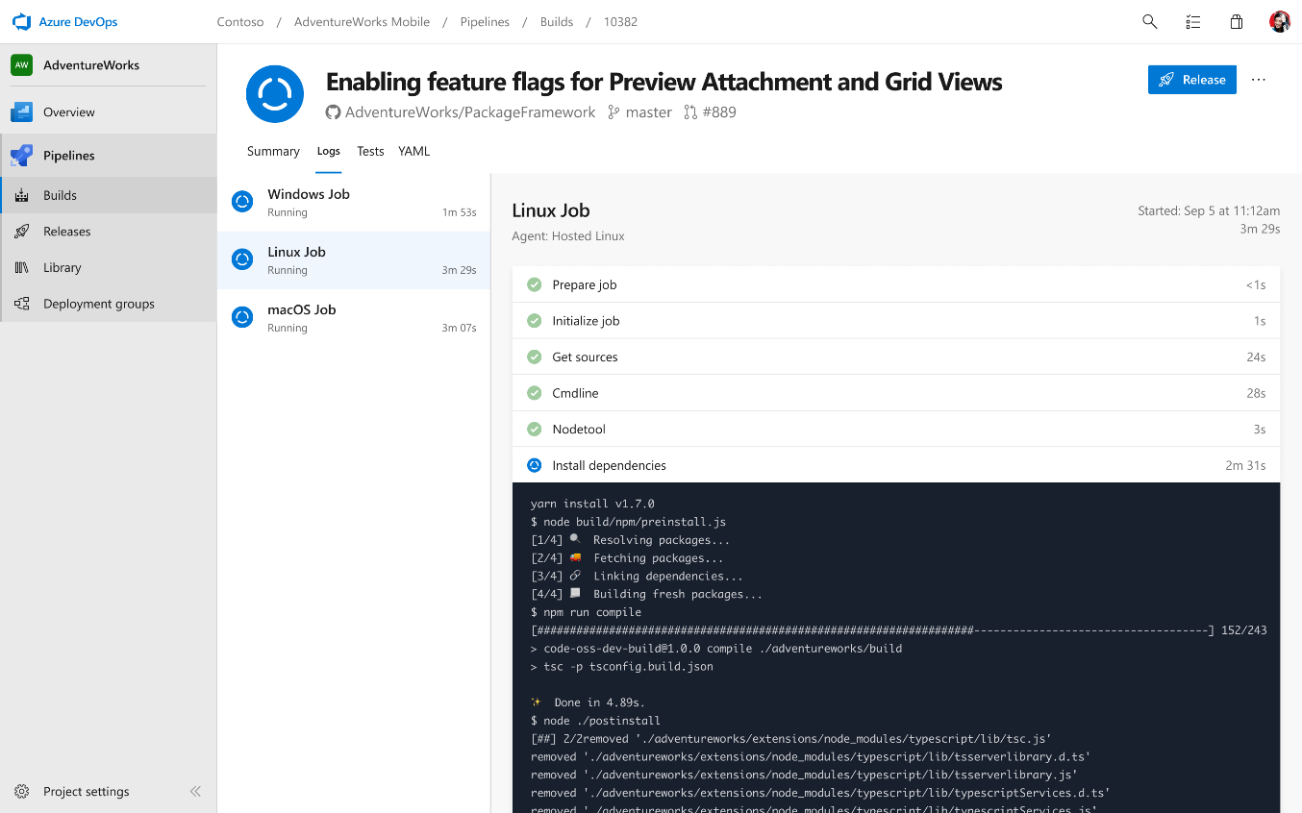
Deliver
Azure Boards
Azure Repos
Azure Pipelines
Cloud-hosted pipelines for Linux, macOS and Windows
Any language, any platform, any cloud
Native support for containers and Kubernetes
Best-in-class for open source
Azure Artifacts
Azure Test Plans

Slide 4
The Process
Create a branch
Develop in your Workspace
Edit the database, then schema compare the changes to the project
OR Edit the project, then publish the database
Use commits along the way
… when you are ready:
Create a Pull Request
Development Lead approves the Pull Request
Your solution is automatically deployed to the Dev environment
The QA team authorizes a release to the Test environment
Assuming the automated release to Dev was ok
Release Manager initiates the release to QA
Release Manager approves the release to Production
If all goes well: Development Lead merges the Pull Request to master, branch goes away

Slide 5
Build and Deploy
SQL Server Data Tools (SSDT) Build
First Stage on the YAML pipeline
Output: artifacts:
A DacPac file (target schema for the database)
ARM Template files to create resources
SQL Scripts for pre-compare step
Automated Deployment
Second and Third Stages on the YAML Pipeline
Deploy Infrastructure
Deploy Schema Changes
A few other steps
Key point: the same build will be promoted from Dev to QA, then to Production - no manual steps.

Slide 6
Typical Solutions & Best Practices (1)
Reference Data → Sproc
Use Stored Procedures with repeatable code to insert/update reference data.
Review the change script before sending the pull request
A project can be schema compared to a Dev or Test environment
A project can be schema compared to a dacpac extracted from a Production environment
Define roles and responsibilities
Folks can wear multiple hats and Release Manager / Dev Lead role can rotate periodically.
Communication is key
Use standups to discuss build lifecycle, pull requests, and decide on releases
Add clear notes to your commits and pull requests

